Slide 1
Group 52: INSIST
GitHub repository URL: https://github.com/uts-ios-dev/project3-group-52
Shiwei Lin 12433126
Jinmiao Cheng 12102909
Renwei Liu 12156218

Slide 2
Outline
1. Target user (Jinmiao)
2. Problem (Renwei)
3. How to solve (Renwei)
4. Demonstration (Jinmiao)
5. Technology (Shiwei)

Slide 3
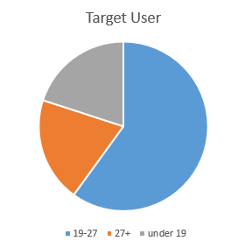
Target User
The target users are someone who like or want to start running or workout insistly.
Someone who want to have a healthy lifestyle.
The percentage of the female users is 55%. (More male like the gym)
The main users’ age are between 19-27. The percentage of the age
between 19-27 is 60%.
5. The INSIST application is a easy to use, maintain and it
provide the best accuracy for the users. Can be used by
anyone including professionals and old people.

Slide 4
Target User
How to get more target users?
Sharing some content including image, video or text about the running or workout in the social media or instagram. The user can use their facebook account to login to the Application.
This application can use the number to tell you how much calories the exercises consumes, let you are full of expectations for the next exercise, at least, you can feel the effect intuitively.
Multiple use of this application. (Help someone has a bad memory to get back to home, or can be used as a stopwatch or calories measurement application).

Slide 5

Problem
Running is a very popular exercise to take up nowadays.
Free
Can be done anywhere, anytime
Strength bones and joints
Run to de-stress
Prevent illness and diseases
However, it is hard to track and record every run.

Slide 6
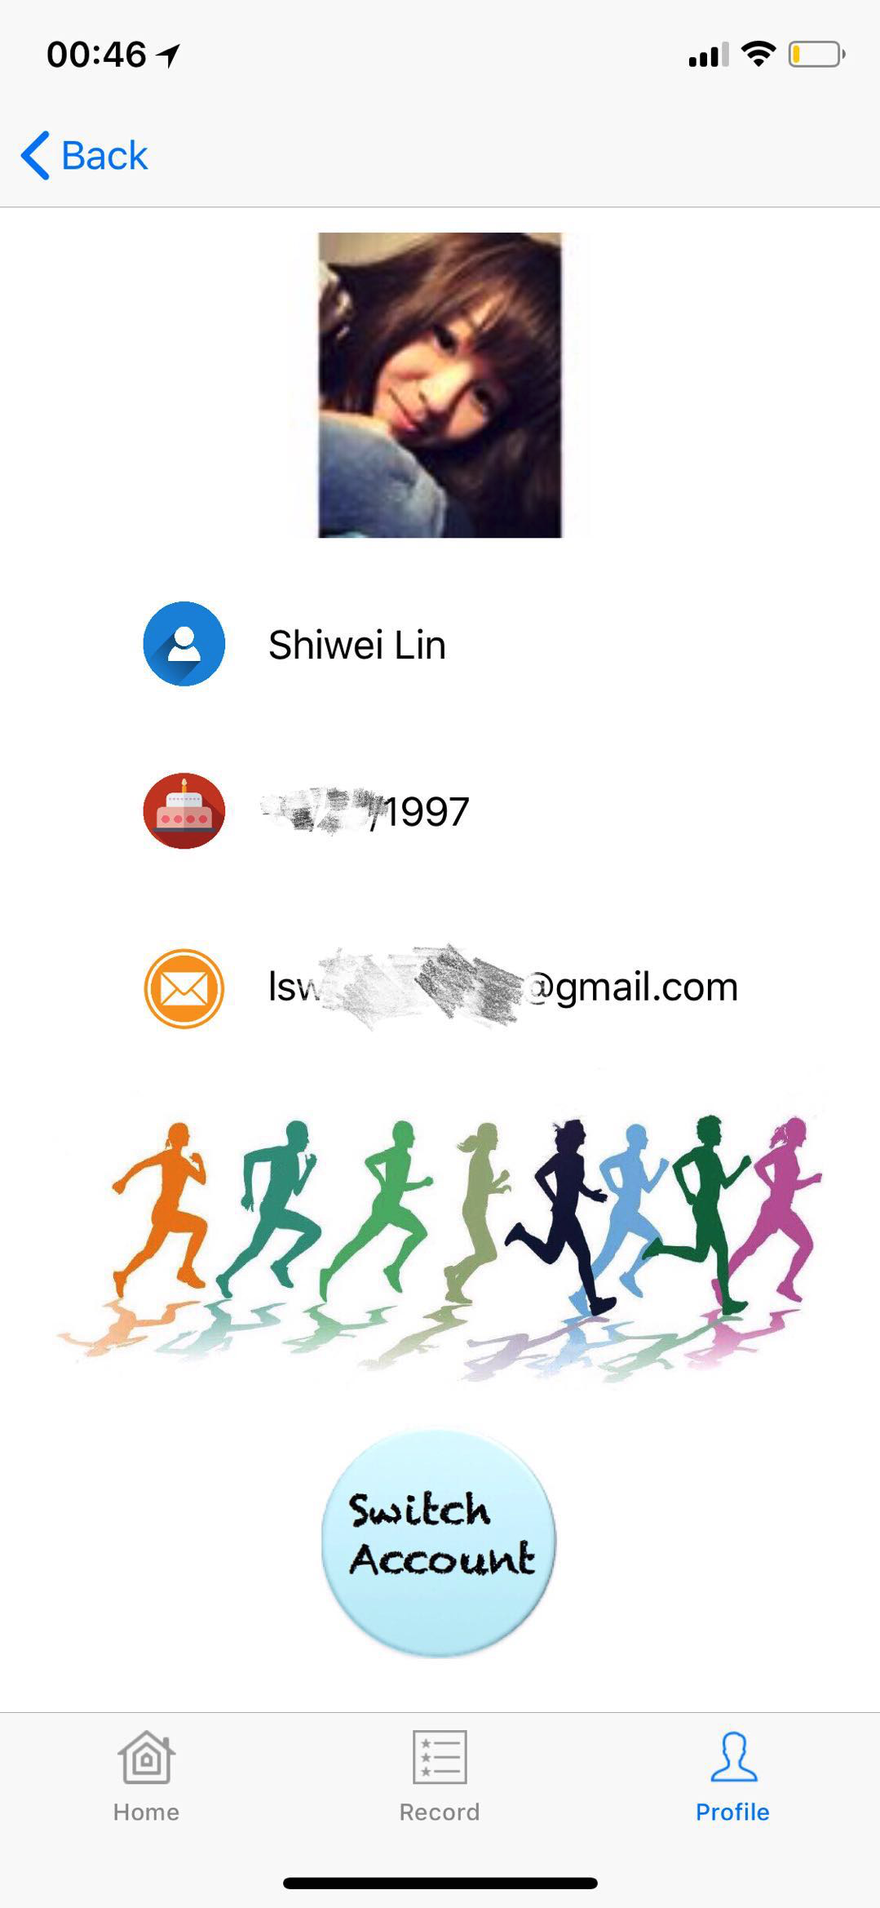
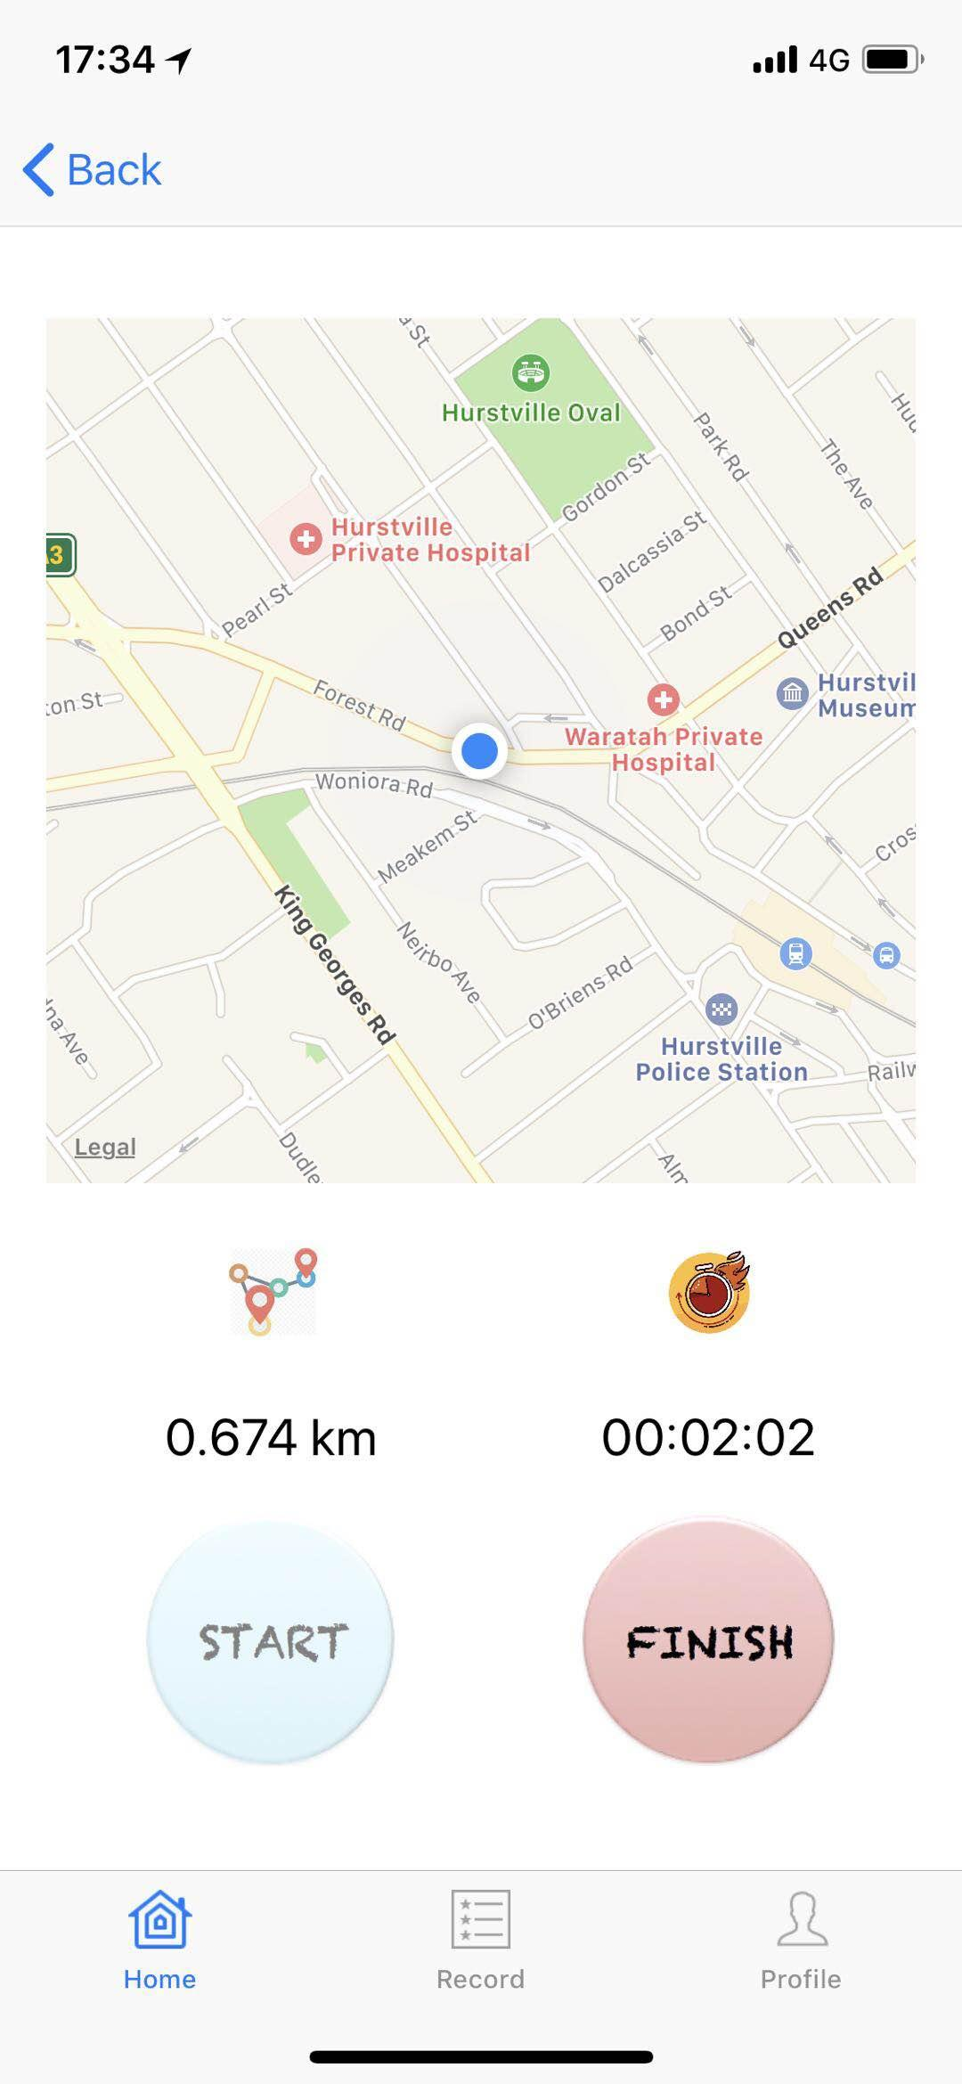
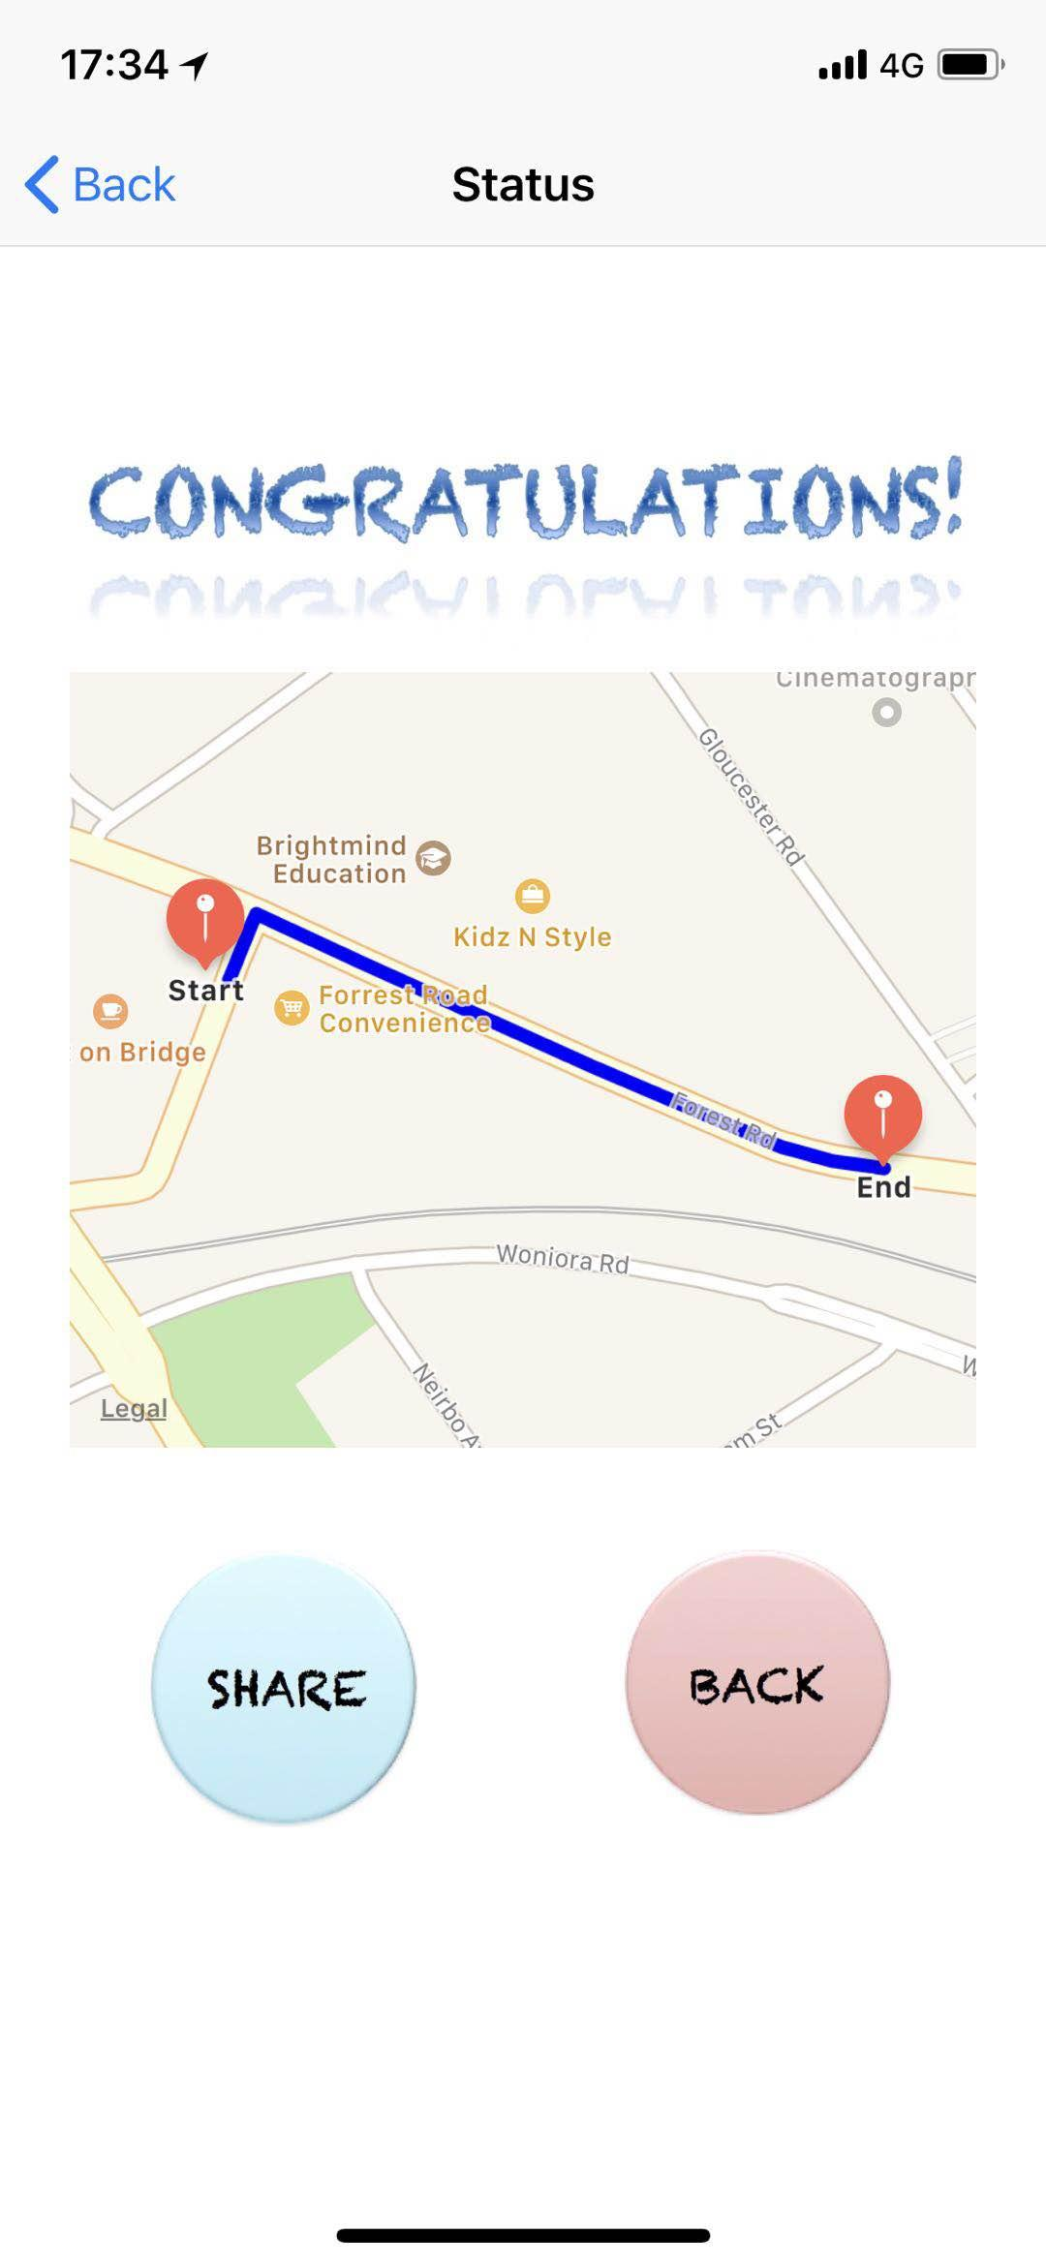
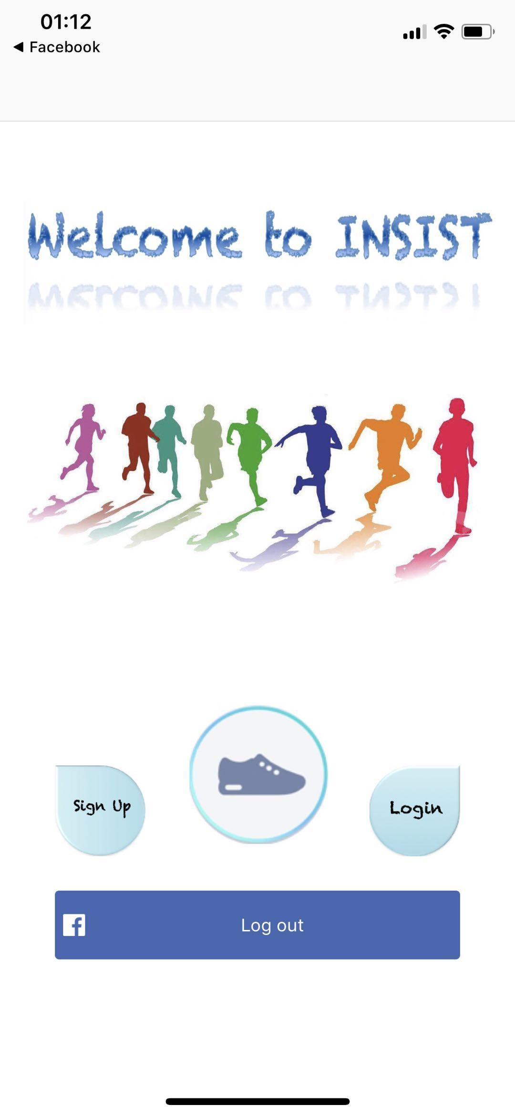
How to solve
Meet INSIST!
Save runner’s information.
Using GPS to track runner’s Movement.

Slide 7
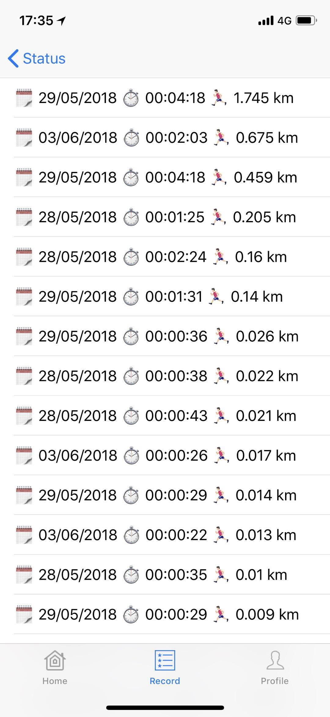
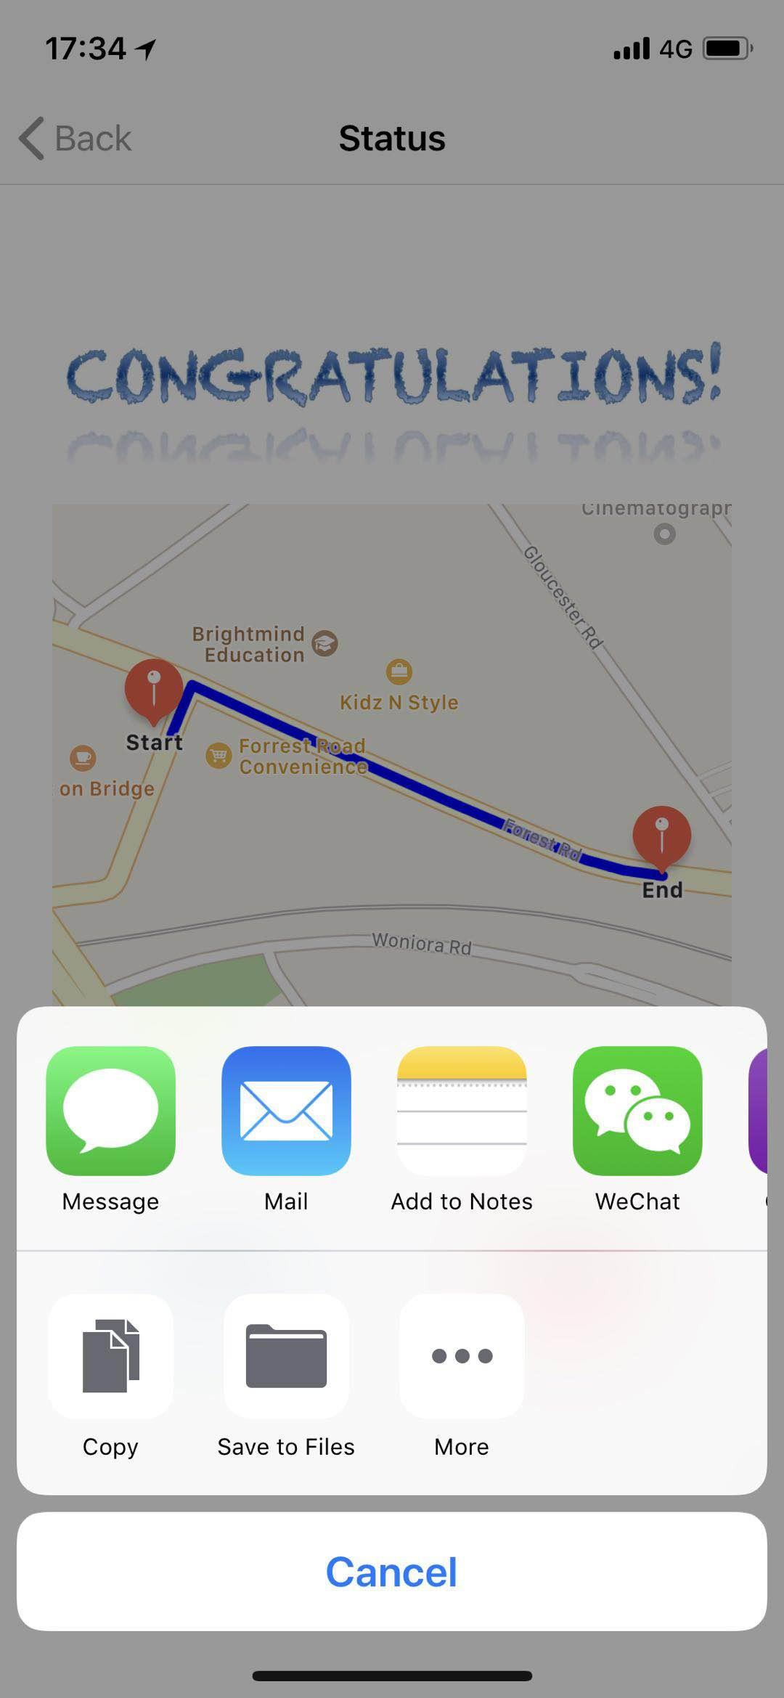
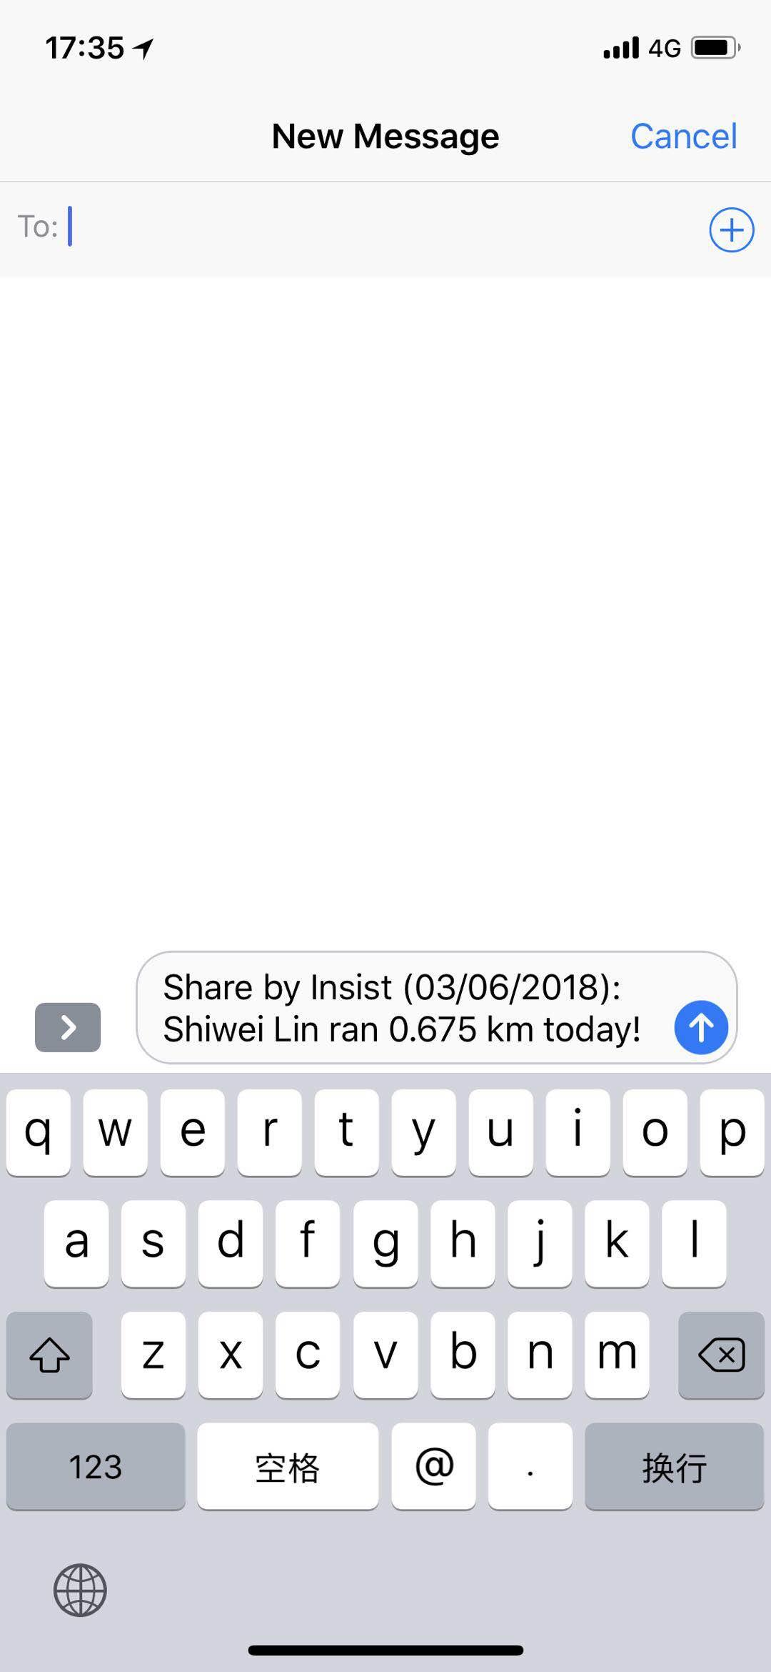
How to solve
Meet INSIST!
Saving record of running every time.
Sharing records with others.

Slide 8
Demonstration
login to the INSIST application
by facebook account, get the login confirmation from the Facebook
register a new account
sign in use a current account
2. Get the login confirmation from facebook.
3. Warm up for the running! Press the “Start” button when you ready!
4. The application will show you the exact number of how much calories you consumed and how long the distance you have run. And also the route will be drawn on the screen.
5. After you stop, press the “Finish” button.

Slide 9
Demonstration
6. The route between your startpoint and endpoint will be drawn on the screen. Each point have their title and subtitle.
7. After that, you can share the running record to facebook or email to each other. Also you can have a look at the running history in the homepage if you want.

Slide 10
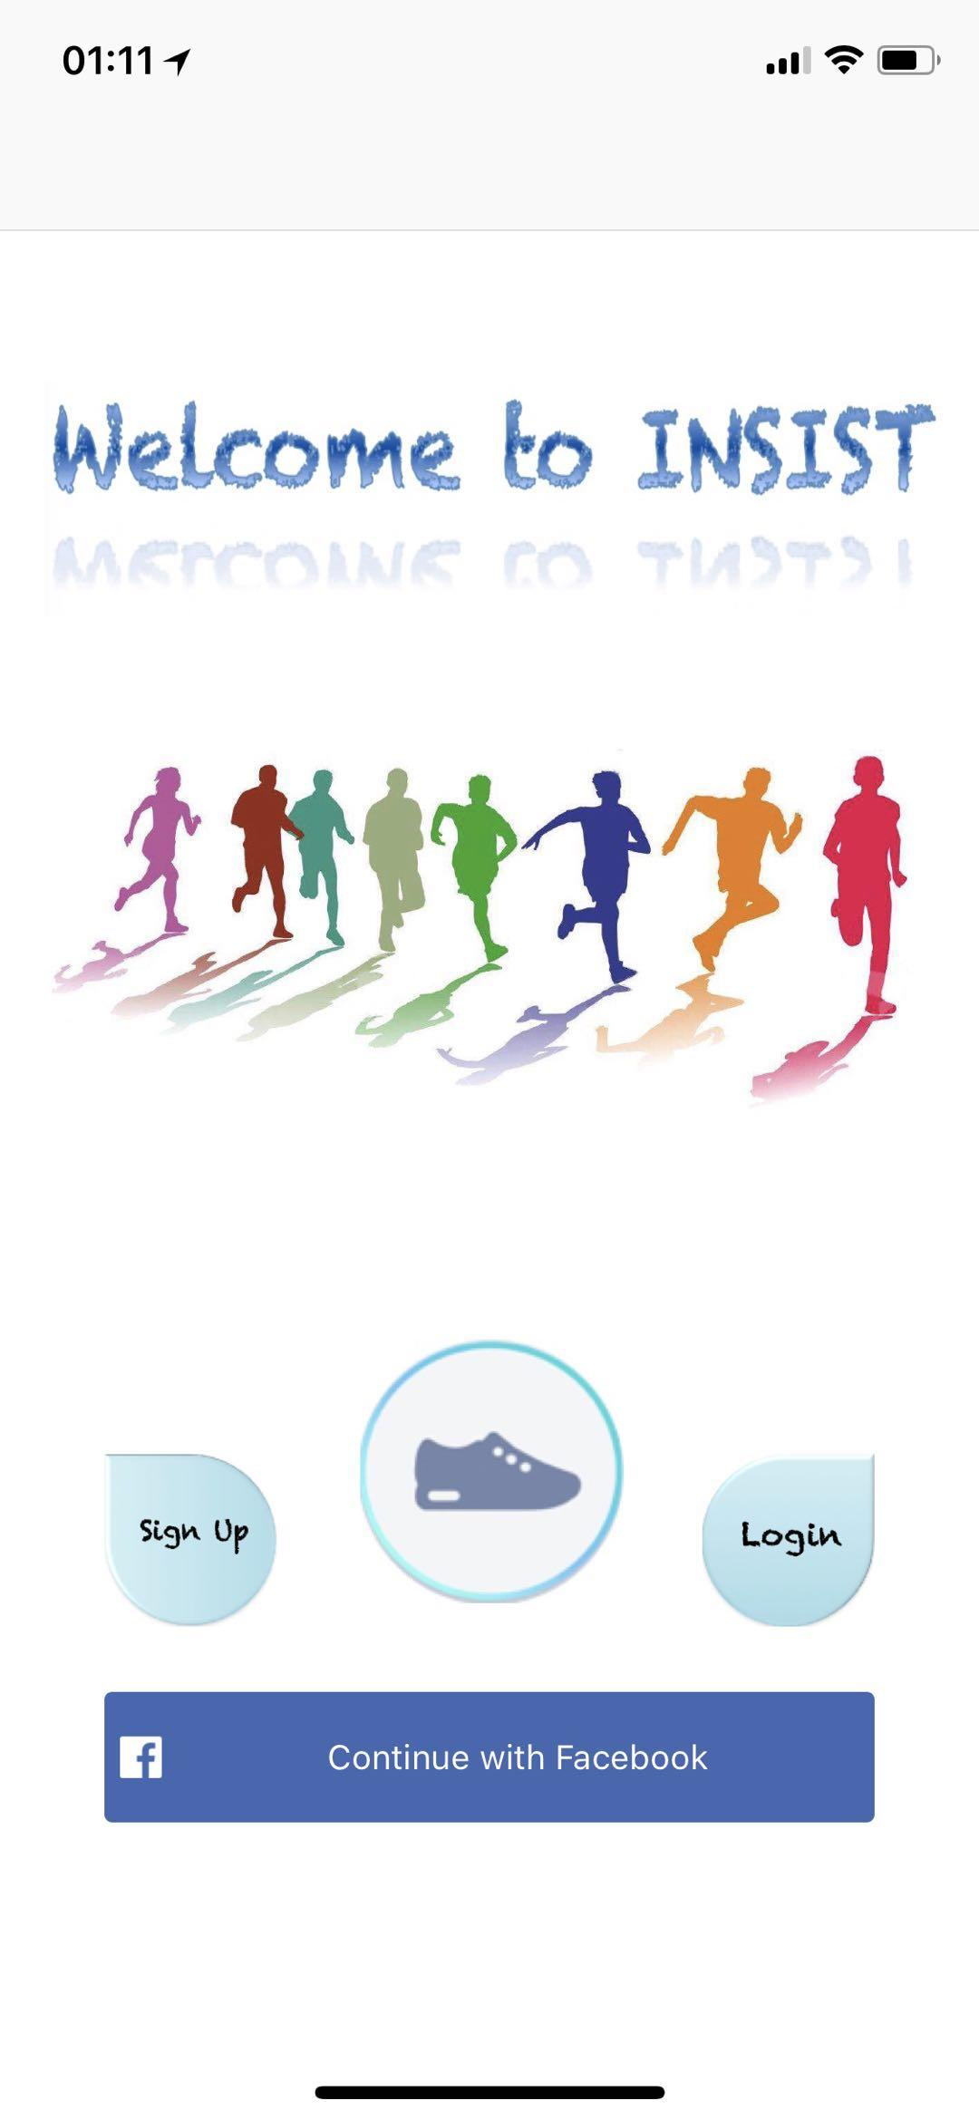
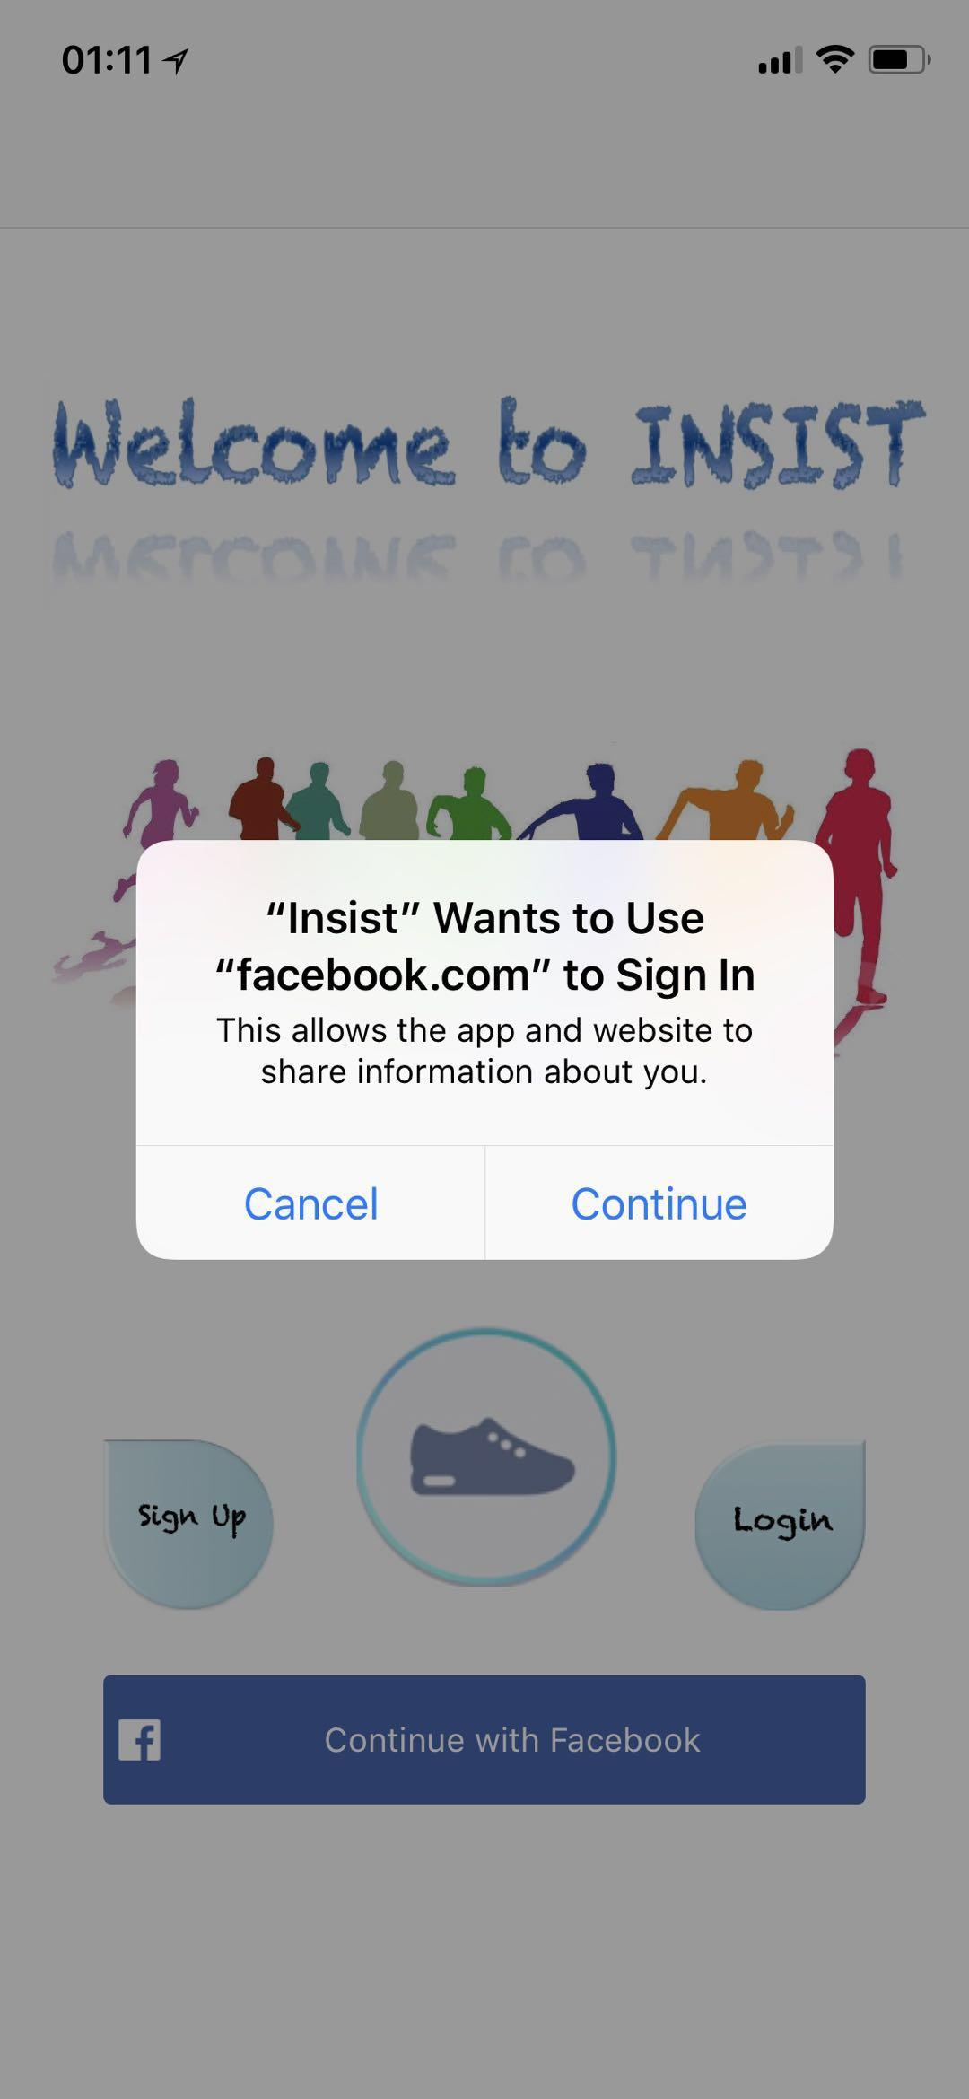
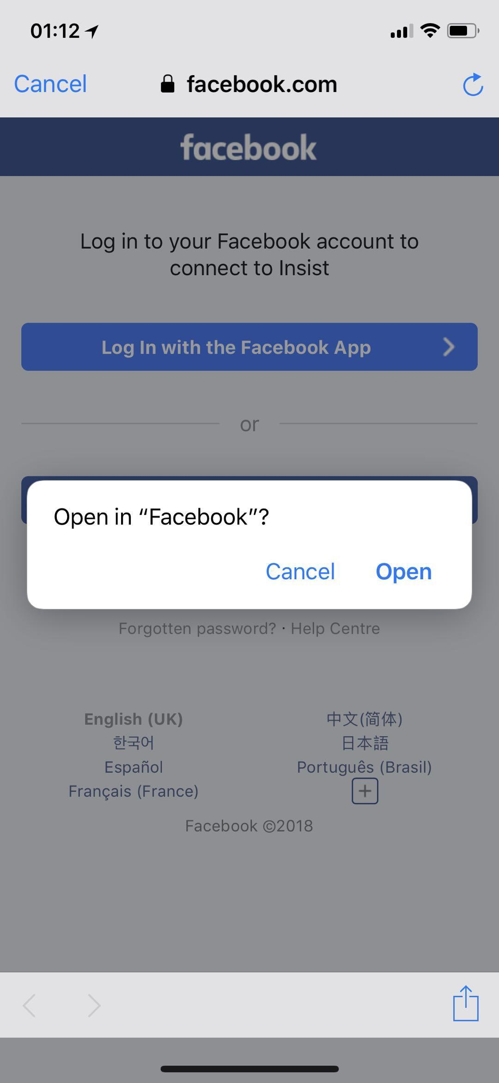
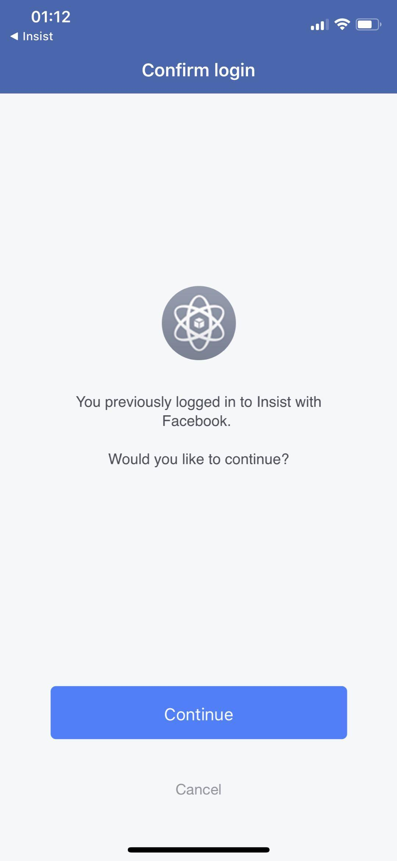
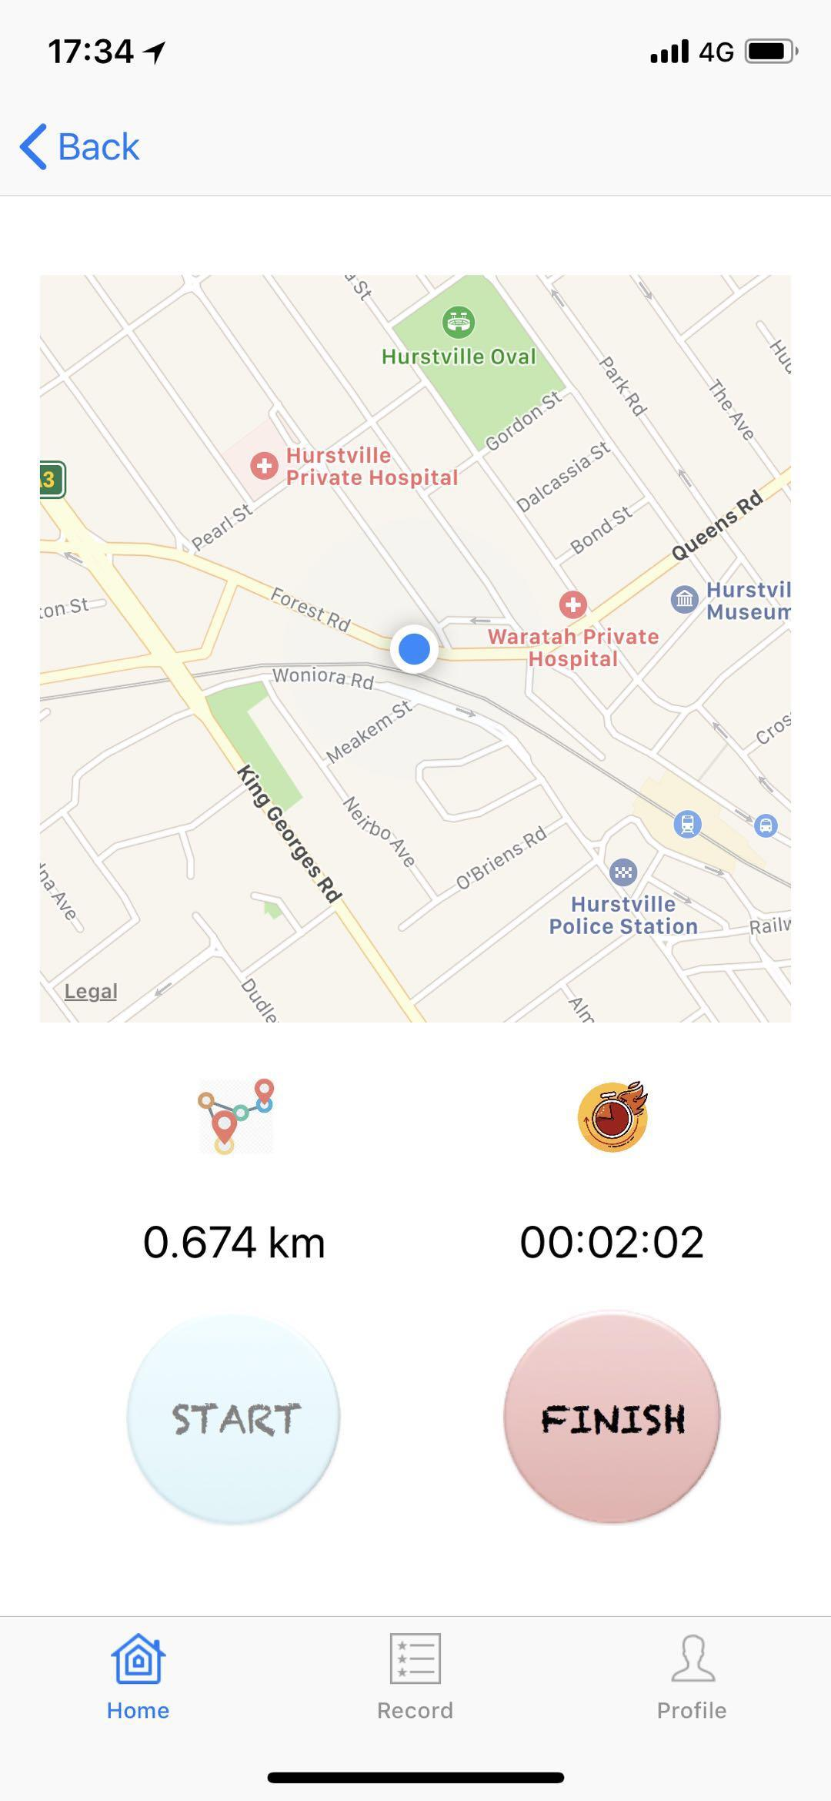

Slide 11
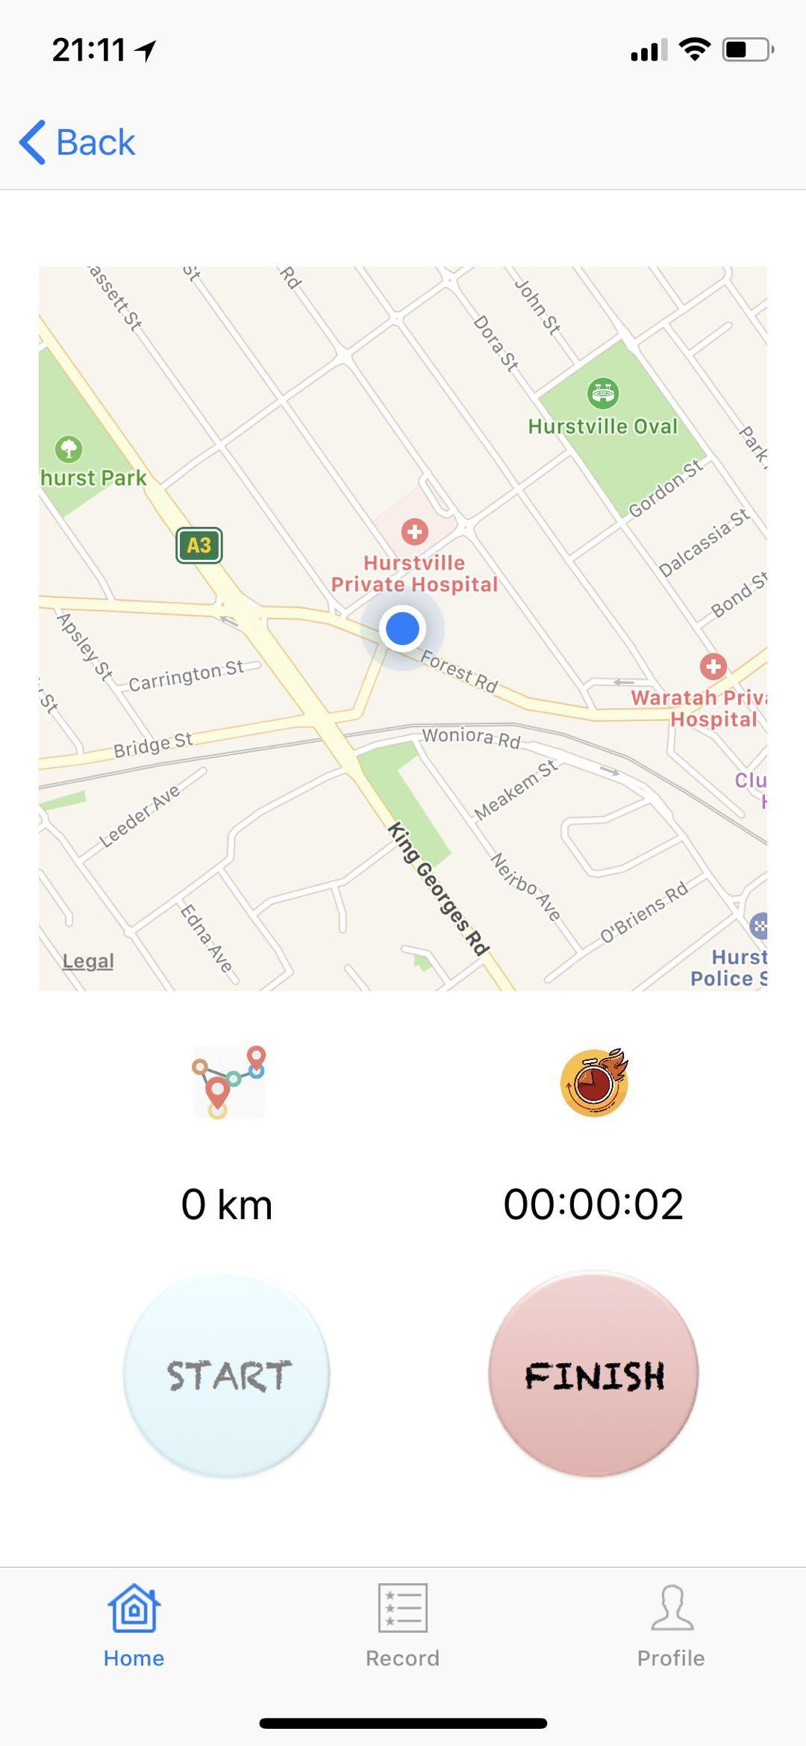



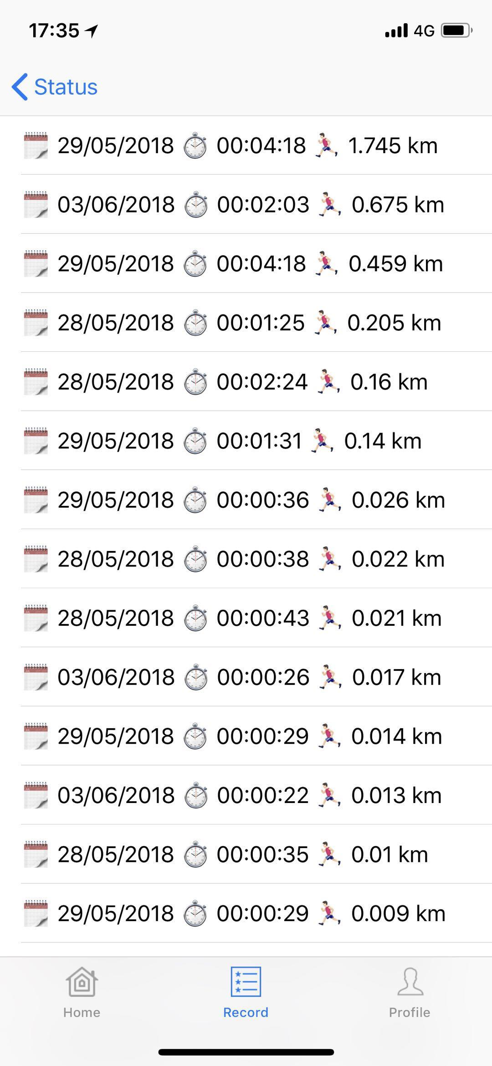
Demonstration

Slide 12
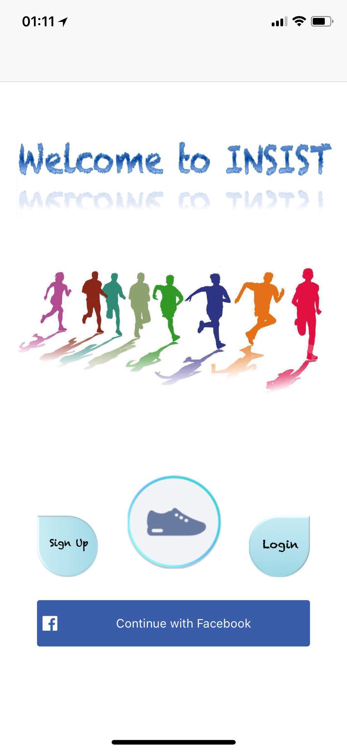
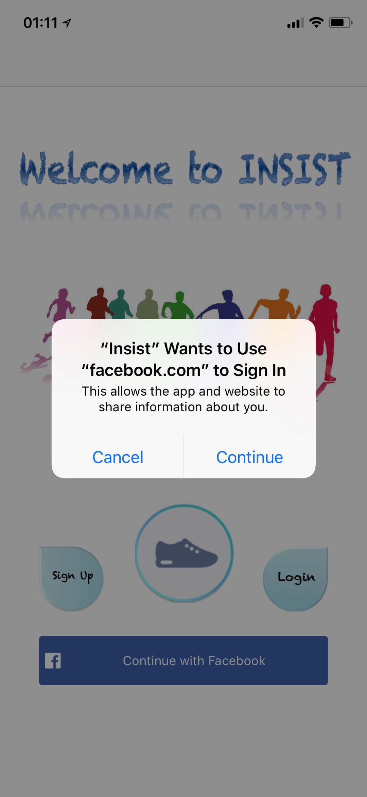
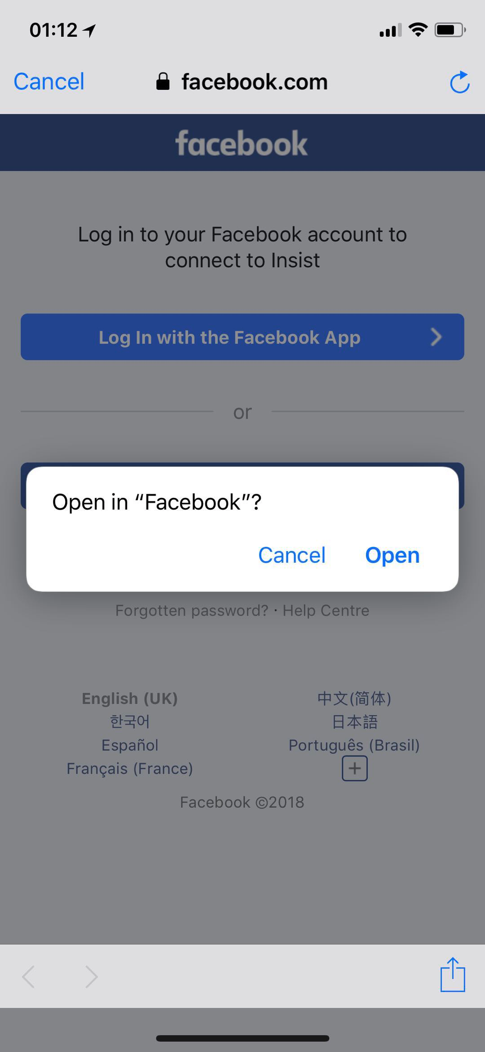
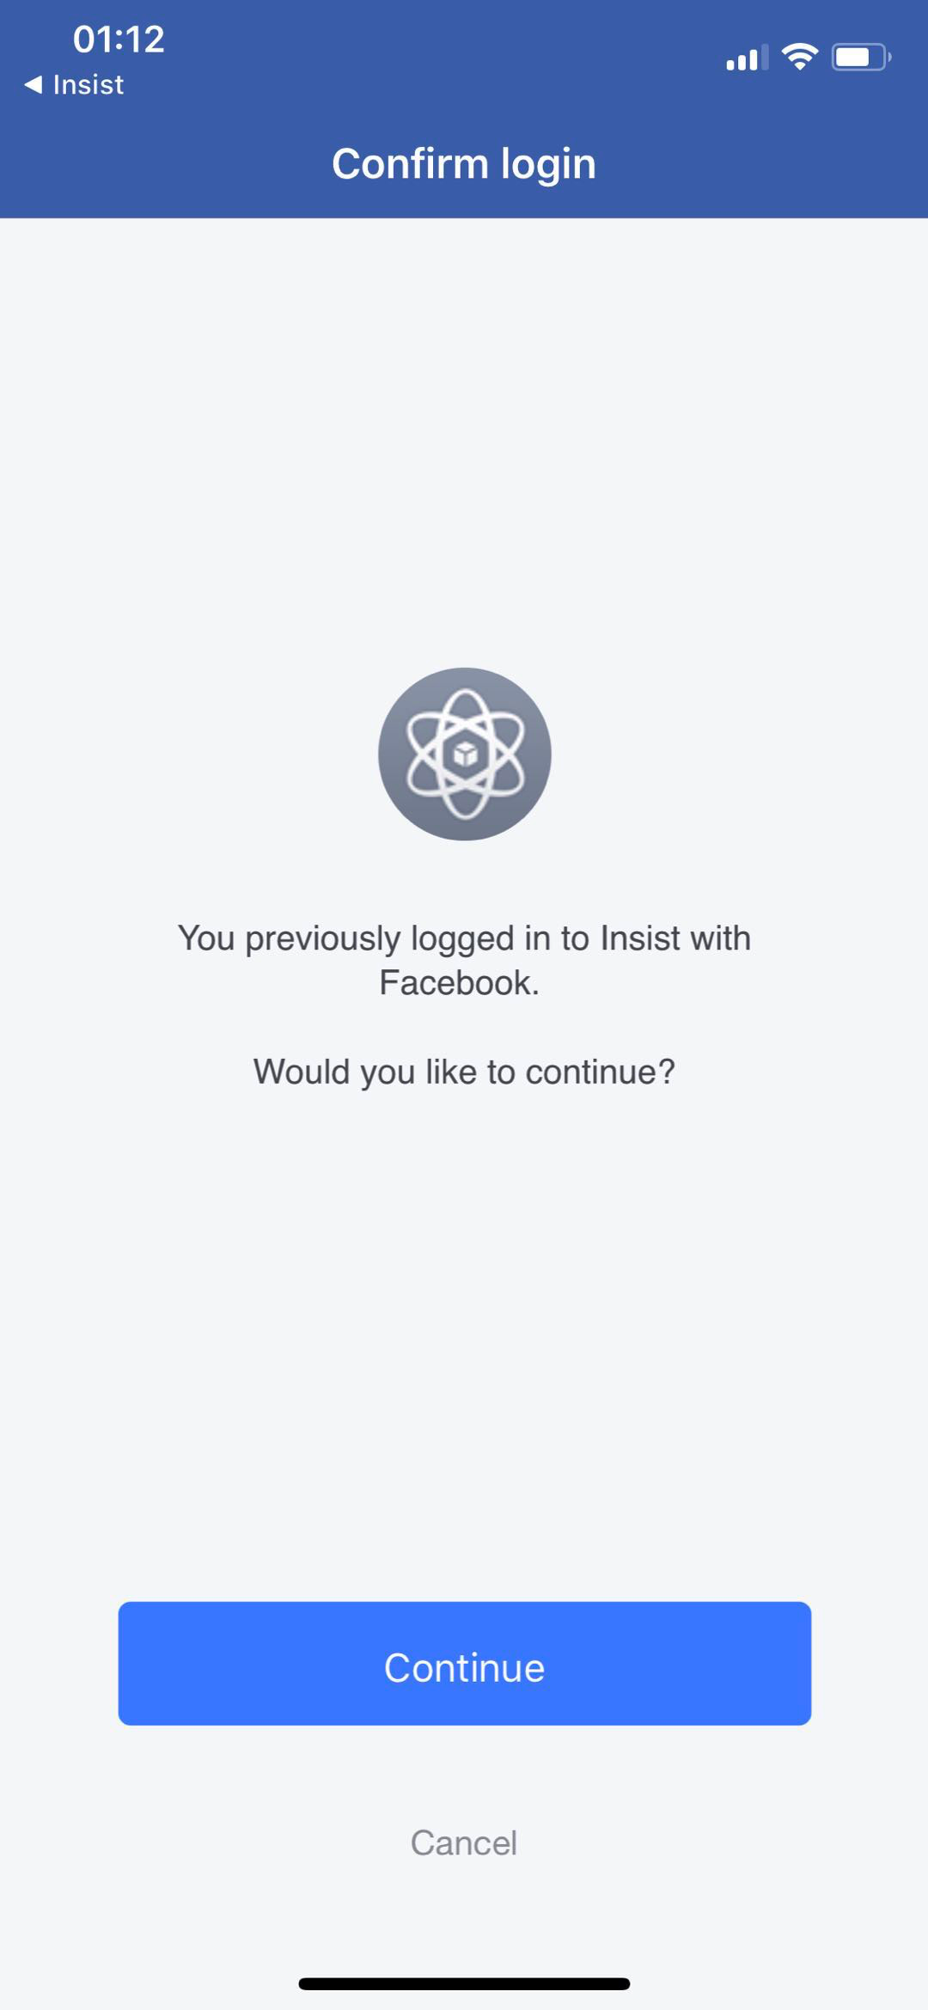
Facebook Login
User can log into Insist with Facebook
Retrieve information with permission
Notes:
S: Our app can login with Facebook and get the Facebook information. The information we need is public profile, birthday and email. I use Facebook login button with read permission and Graph Request to get the user data. Graph Request is a single request to be sent to the Facebook Platform through the Graph API.

Slide 13
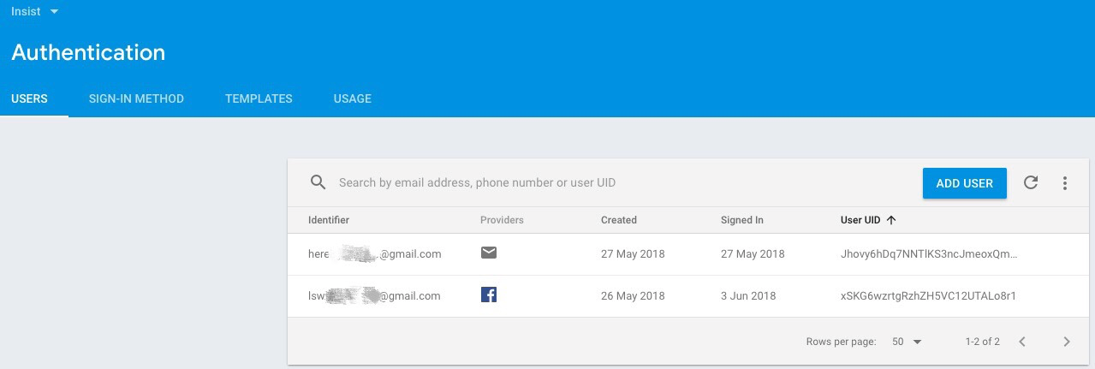
Facebook Login & Firebase
Combine Facebook Login with Firebase Authentication
Securely save user data in the cloud
Use email address as identifier (for authentication and firestore)
How to code: https://developers.facebook.com/docs/swift/login
https://firebase.google.com/docs/auth/ios/facebook-login
Notes:
S: Then combine Facebook Login with Firebase Authentication by credential. Firebase securely saves user data in the cloud, and we use email address as identifier for different users. Once the user logged in by Facebook, the user will be added to Firebase Authentication automatically with Facebook providers.
There are two links for how to code Facebook login and combine Facebook login with Firebase. If anyone is interested, you can have a look after the class.

Slide 14
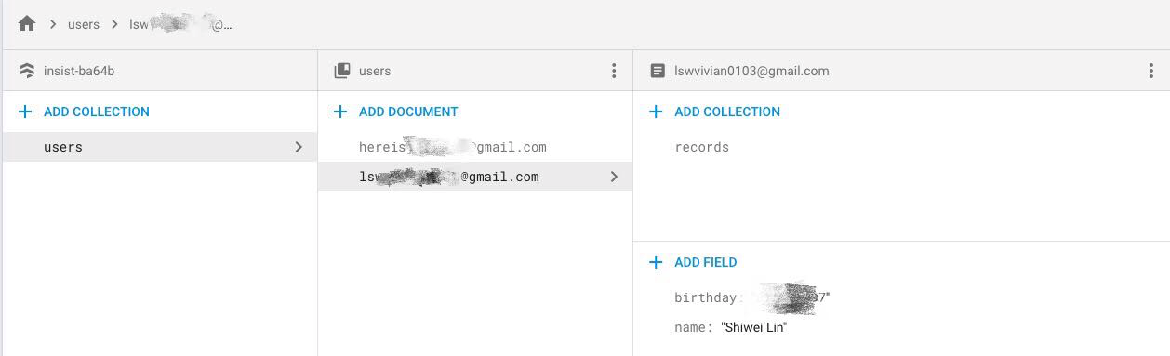
Facebook Login & Firebase
Save the runner information into Firebase Cloud Firestore
Display the runner information in profile page
Figure: Firebase Cloud Firestore
Figure: Profile
Notes:
S: We get user Facebook data, then save in Firebase Cloud Firestore and display in our profile page. We also use email address as user identifier for Firestore. I will introduce Firestore later. But the basic thing is we use one collection for users, and different user document. Each document has user birthday and name, and we use Email as document ID. You can assume that users collection is an array for users, and each user document is object in the array.

Slide 15
Firebase Authentication
Email and password based authentication
Check whether the email address is valid or registered
Check whether the password is at least 6 characters long
How to code: https://firebase.google.com/docs/auth/ios/start
Notes:
S: Also, we can use email and password authentication. When user is processing register in our app, Firebase checks the email address and password validation. The email address must be valid and hasn’t been registered. The password must be longer than or equal to 6 characters long.

Slide 16
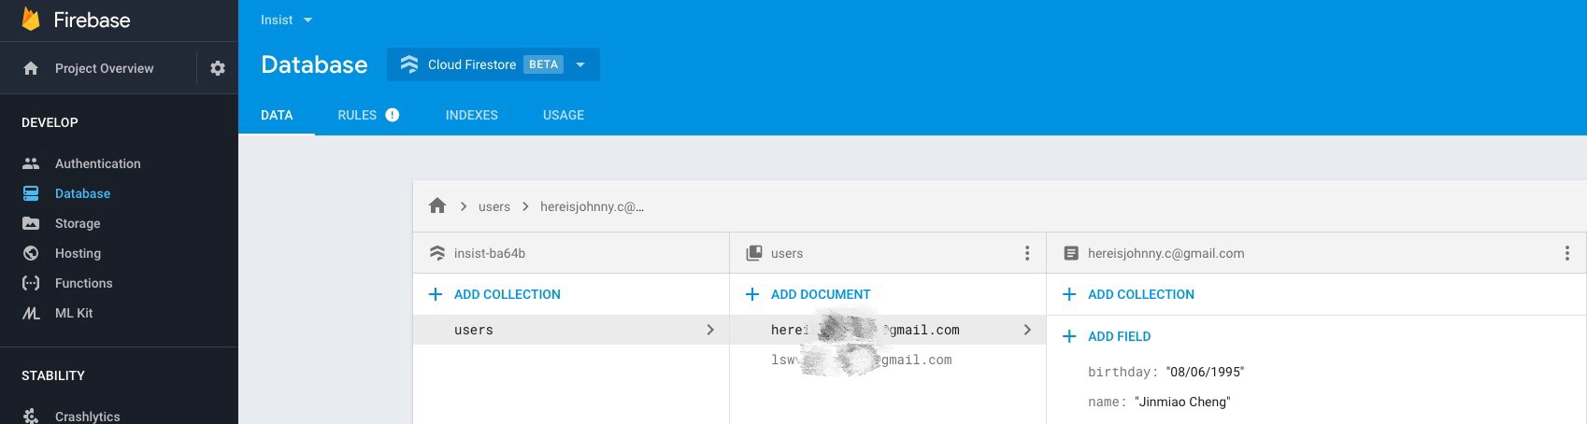
Firebase Authentication
Save the runner information into Firebase Cloud Firestore
Display the runner information in profile page
Notes:
S: Then it follows the same process as Facebook login.

Slide 17
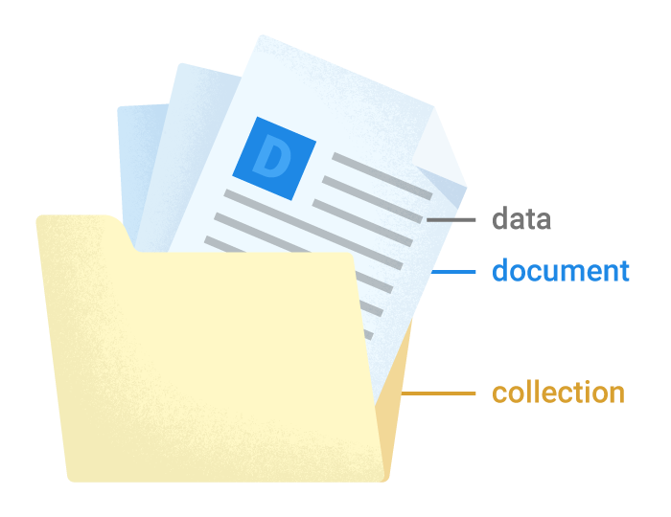
Firebase Cloud Firestore
Keeps runners data in sync
Stores data in documents organized in collections.
Complex, hierarchical data is easier to organize at scale, using subcollections within documents.
Easy to code
Cloud Firestore vs. Realtime Database: https://firebase.google.com/docs/database/rtdb-vs-firestore
How to code: https://firebase.google.com/docs/firestore/quickstart
Notes:
S: Firestore keeps runners data in sync, and stores data in documents organized in collections. Complex, hierarchical data is easier to organize, using subcollections within documents, and it is easier to add and manage data than Real time database. Because in our case, we need a subcollections for records for the different user, we choose Firebase rather than real time database.

Slide 18
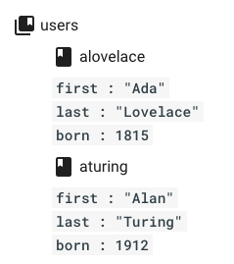
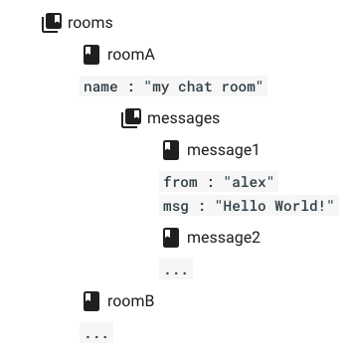
Collections and subcollections Example
Notes:
S: Now, we have a look at the example for understanding the collections and subcollections. The example of users are simple collections with two documents, and each document has three fields. The example of rooms has two documents, one is Room A, the other one is Room B. Room A has subcollections of messages, and messages collection have two documents here.

Slide 19
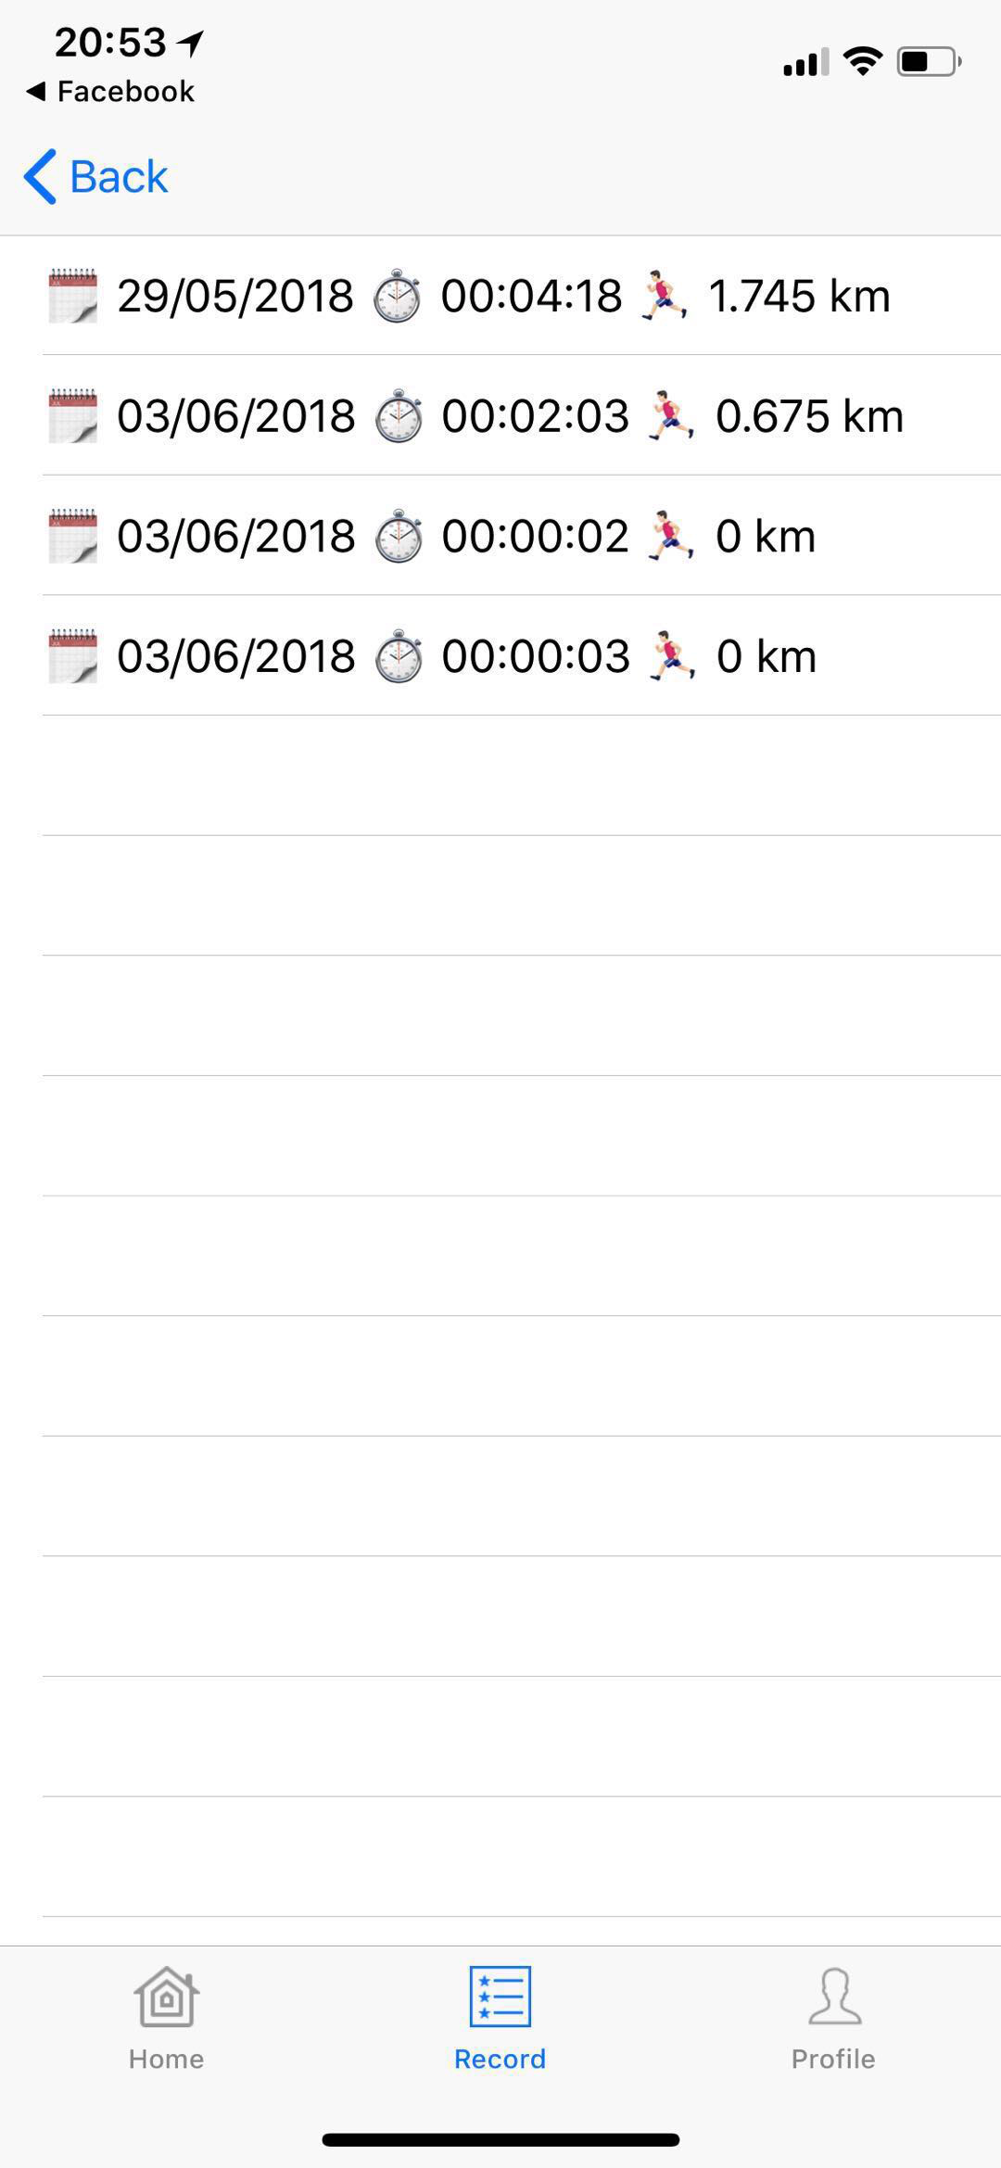
Firebase Cloud Firestore
A record is saved in Firestore once the Finish button is clicked
Switch to Record page, the records are updated automatically and ordered by distance
Figure: During running Figure: Record
Notes:
S: In our app, once the Finish button is clicked, the record is saved in Firestore automatically, and when we enter the record page, the records are updated and order by distance.

Slide 20
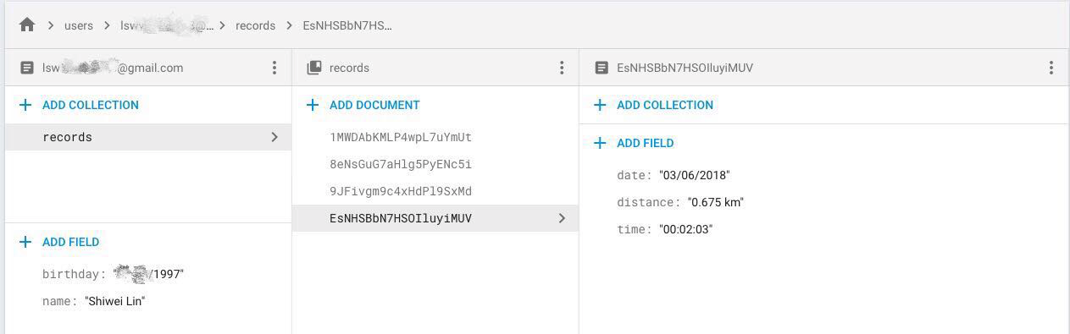
Firebase Cloud Firestore
One collections for users, and the subcollections (records) within particular user document
How to code: https://firebase.google.com/docs/firestore/data-model
Notes:
S: Back to my Firebase console, you can see the users collection with user documents, and each document has birthday and name and record subcollection. Then we click on records collection, there are every record documents, with date, distance and time data.

Slide 21
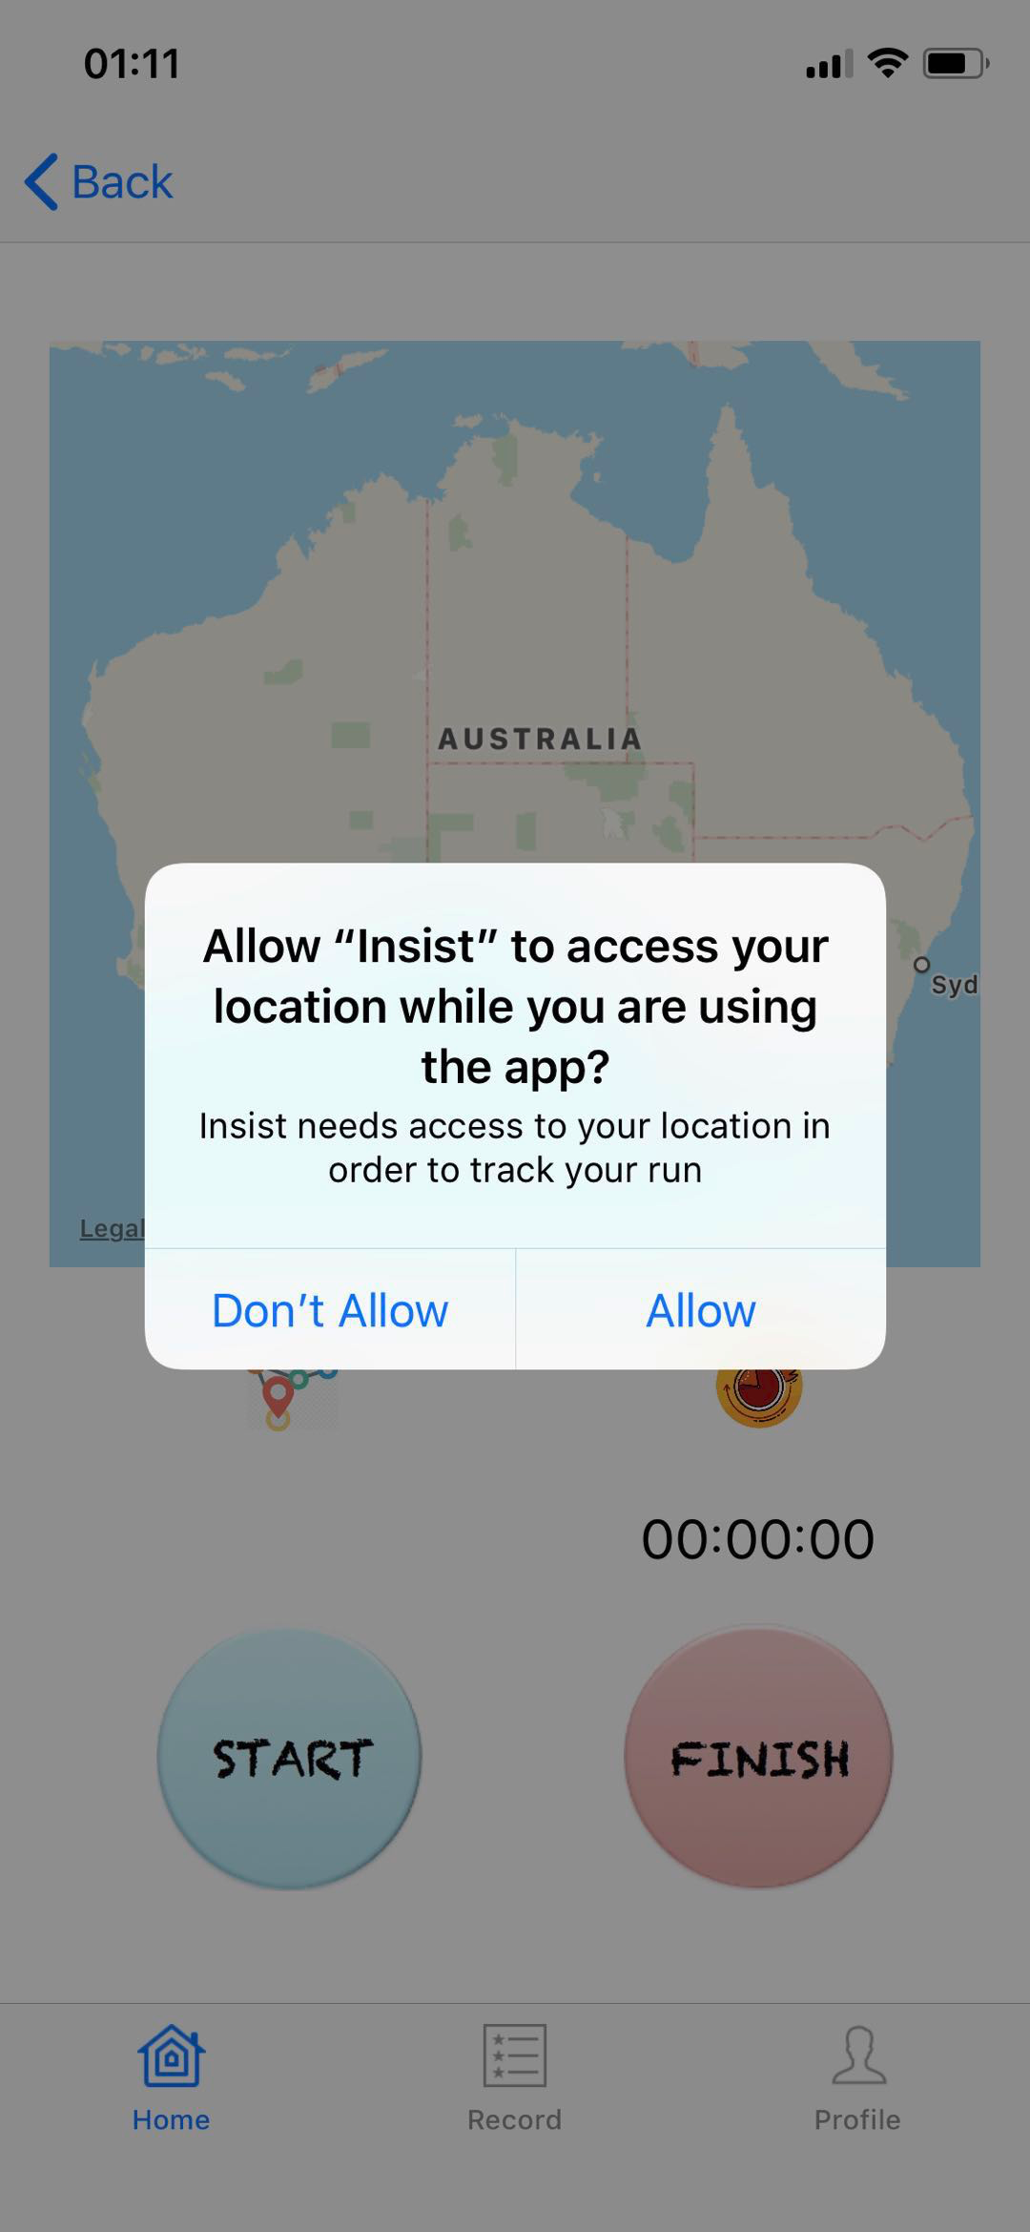
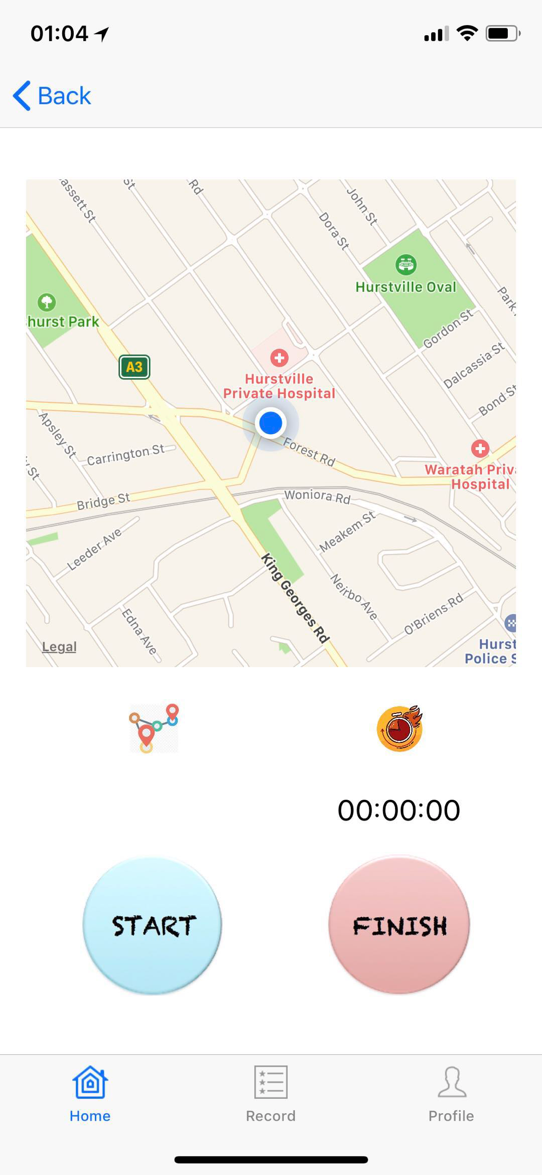
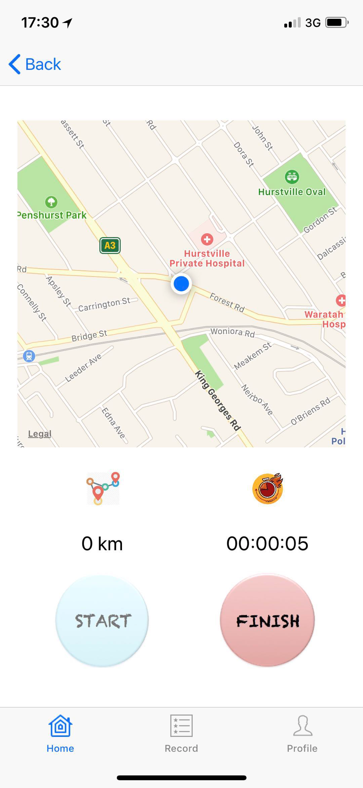
MapKit
Ask for location service permission
Display runner current location
How to code: https://developer.apple.com/documentation/corelocation/cllocationmanager
Notes:
S: Additionally, we use Mapkit and location manager to get user current location once we have location service permission. Location manager supports location-related activities.

Slide 22
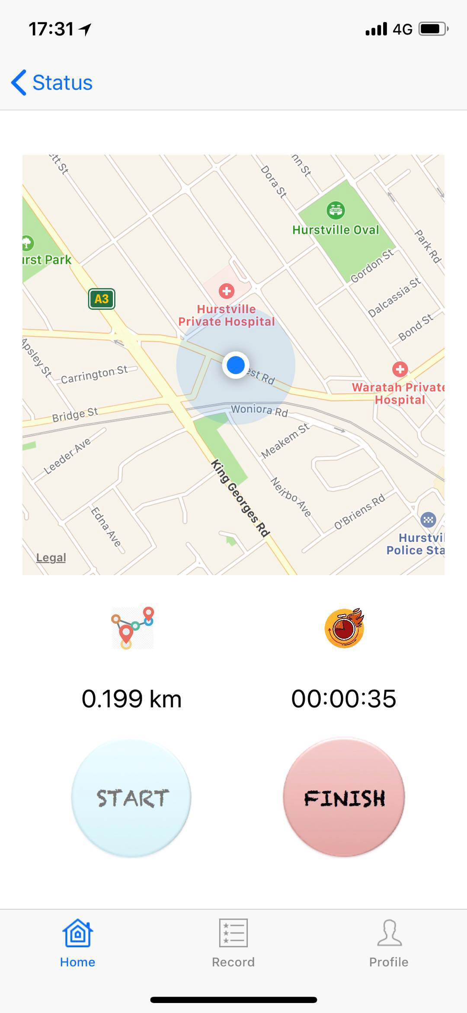
MapKit
Keep updating location and distance during running
Set the placemark and route in Finish page
How to code: https://stackoverflow.com/questions/25296691/get-users-current-location-coordinates
Notes:
S: Then the app keeps updating location and distance during running by Location Manager. Once the Finish button is clicked, the route and placemark is displayed in Finish page.

